Slide 1
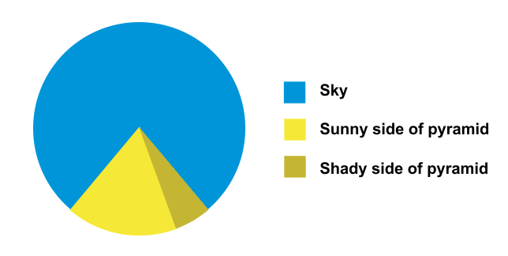
A very brief overview of topics in data visualization

Slide 2
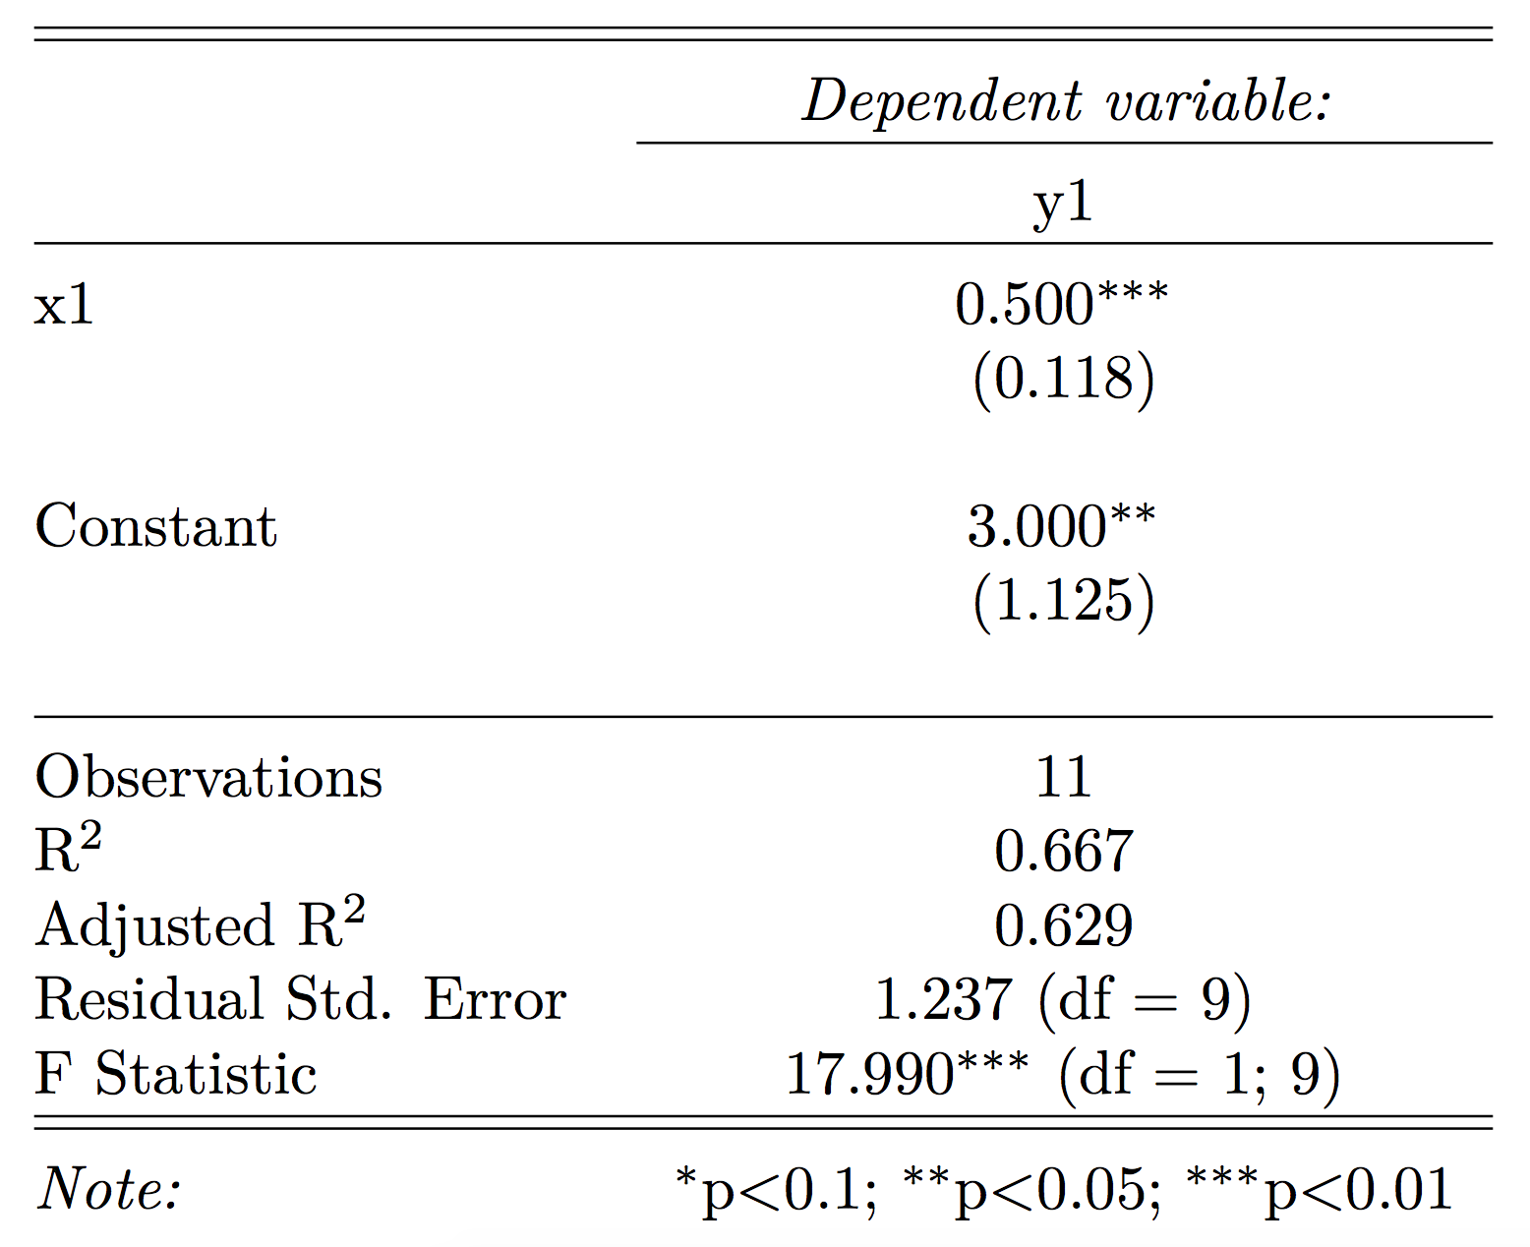
Why visualize data?
Why? | Types | Chart selection | Aesthetics and design | How?

Slide 3
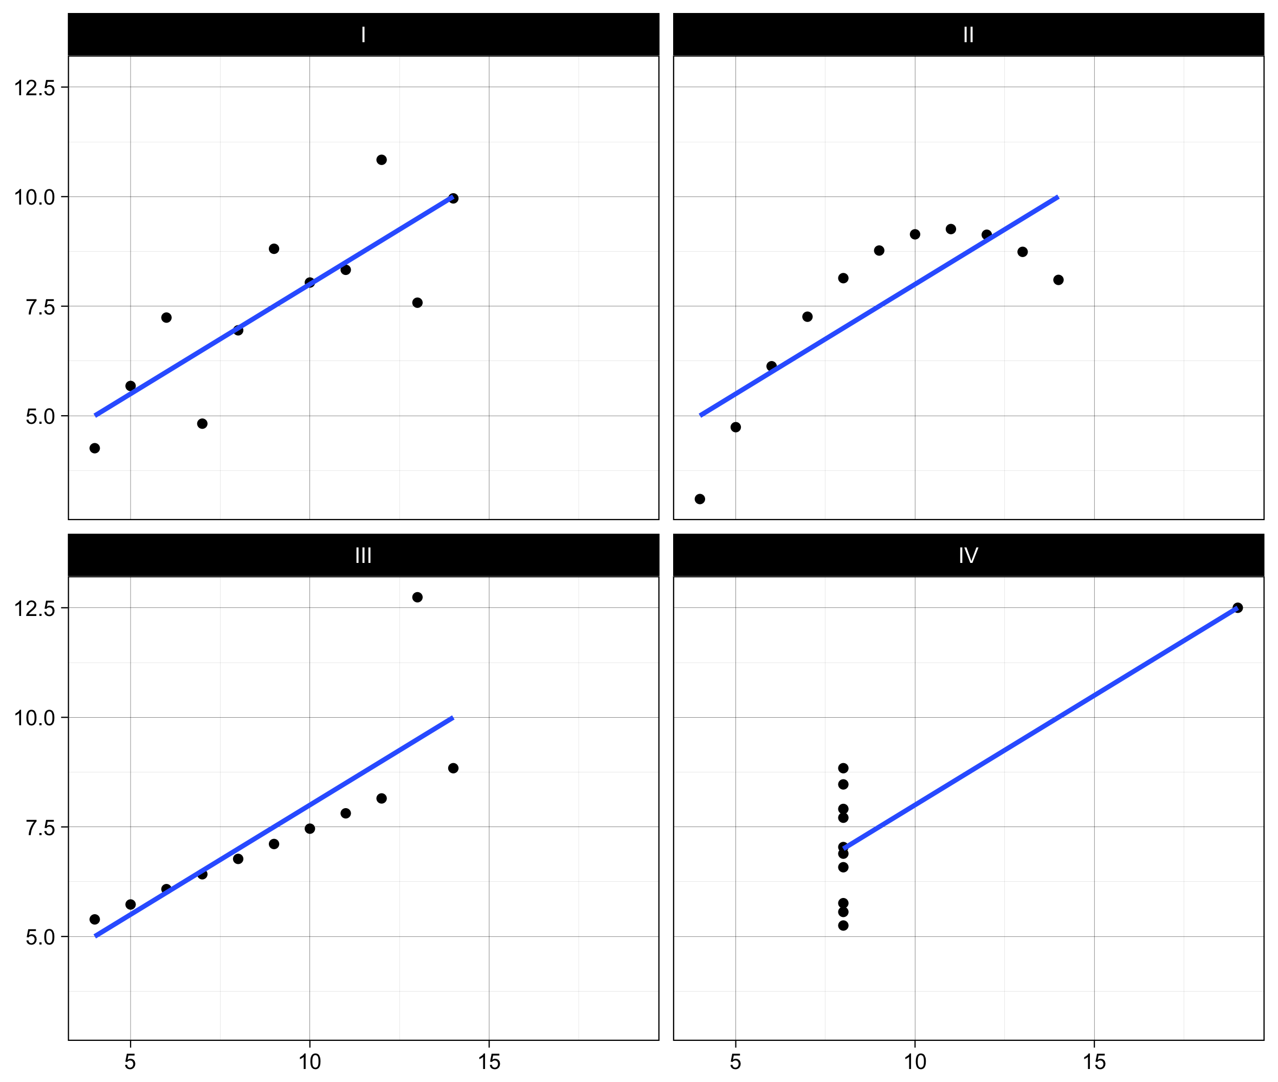

Slide 4
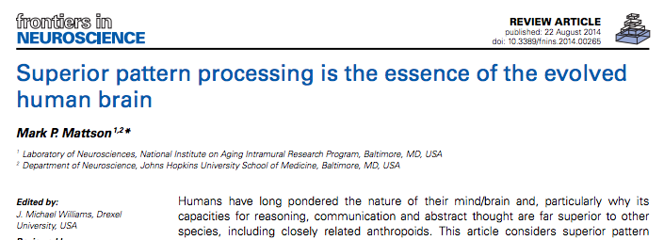


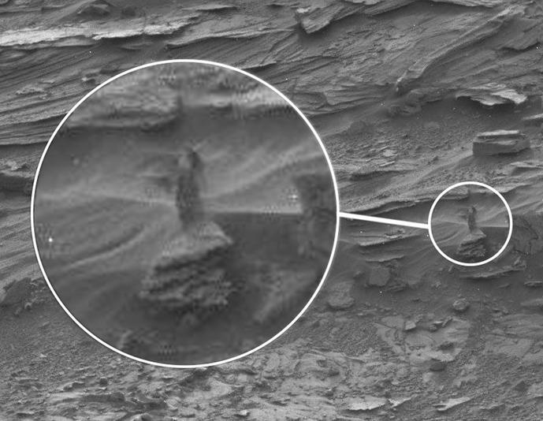
We are visual creatures
Why? | Types | Chart selection | Aesthetics and design | How?

Slide 5
General topics in visualization
Types of visualization
Chart selection
Aesthetics and design
Technical know-how
Why? | Types | Chart selection | Aesthetics and design | How?

Slide 6
Two types of visualization
Exploratory (academic-ish)
Scatterplots, histograms, etc.
Explanatory (publishable-ish)
Your MP, Vox, FiveThirtyEight, NYT
Why? | Types | Chart selection | Aesthetics and design | How?

Slide 7
Exploratory Data Analysis
“Interocular traumatic impact”
Enhance probabilistic analysis
Check shape and assumptions
Why? | Types | Chart selection | Aesthetics and design | How?
Notes:
John Tukey, William S. Cleveland, Joseph Berkson – “Sometimes visualization can fully replace the need for probabilistic inference. We visualize the data effectively and suddenly, there is what Joseph Berkson called interocular traumatic impact: a conclusion that hits us between the two eyes” (via http://development.thinkingwithdata.com/show.php?p=workshop.html)
Rival to forecasting and inferential schools of thought

Slide 8
EDA: Understand your data
Visualize every variable individually
Visualize relationships between variables
Visualize models
Why? | Types | Chart selection | Aesthetics and design | How?
Notes:
Before you run any models, check all the variables you’re using

Slide 11
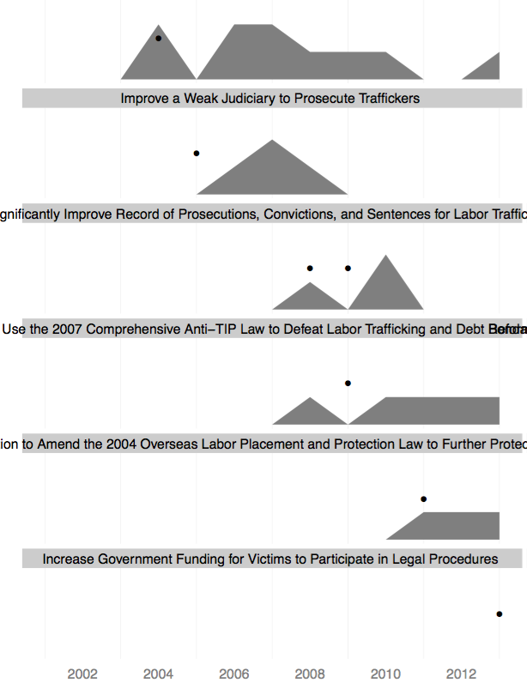
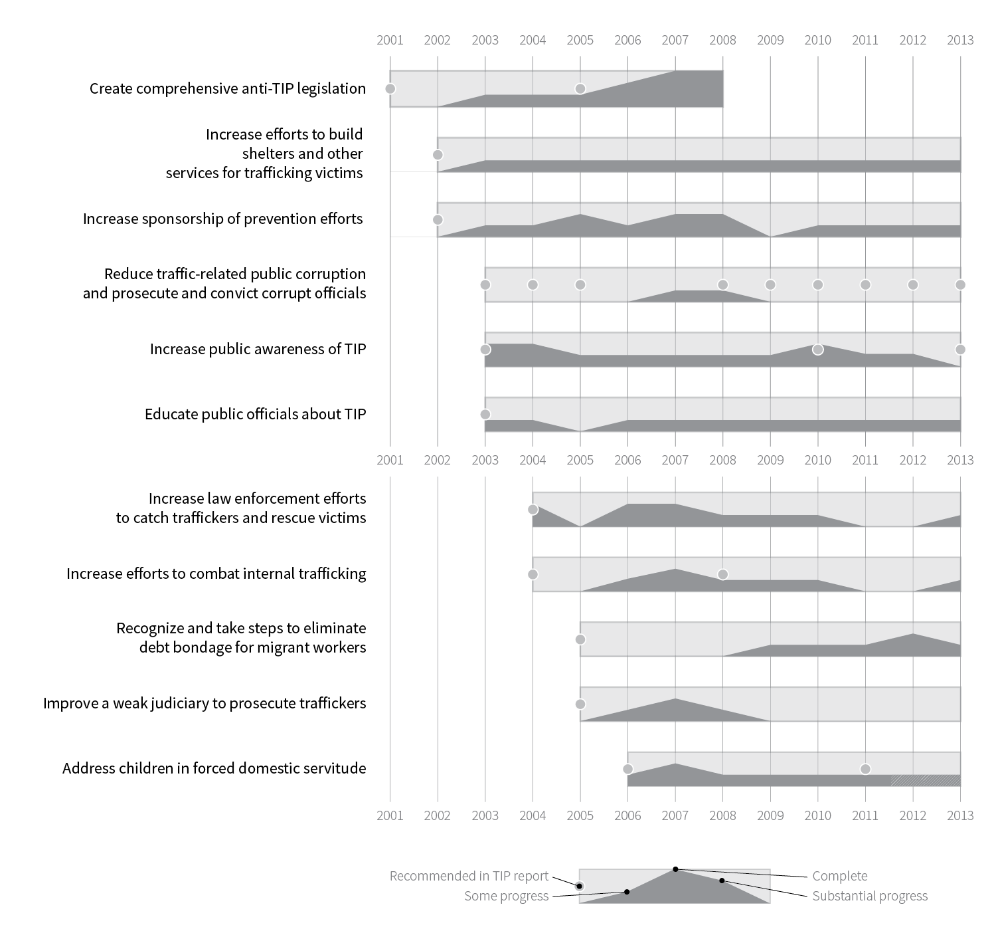
Technical vs. publishable
Why? | Types | Chart selection | Aesthetics and design | How?

Slide 12
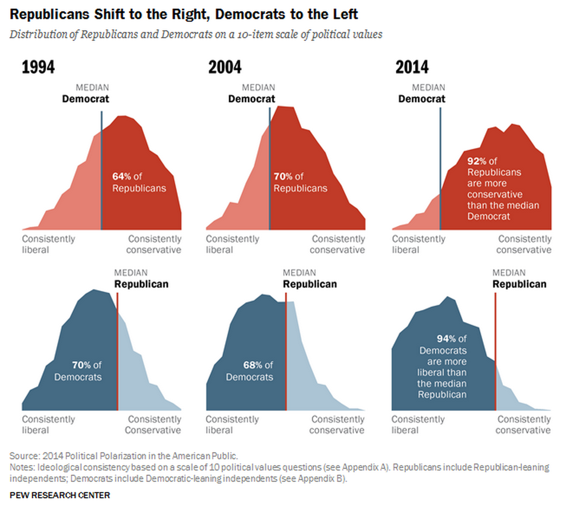

Slide 13
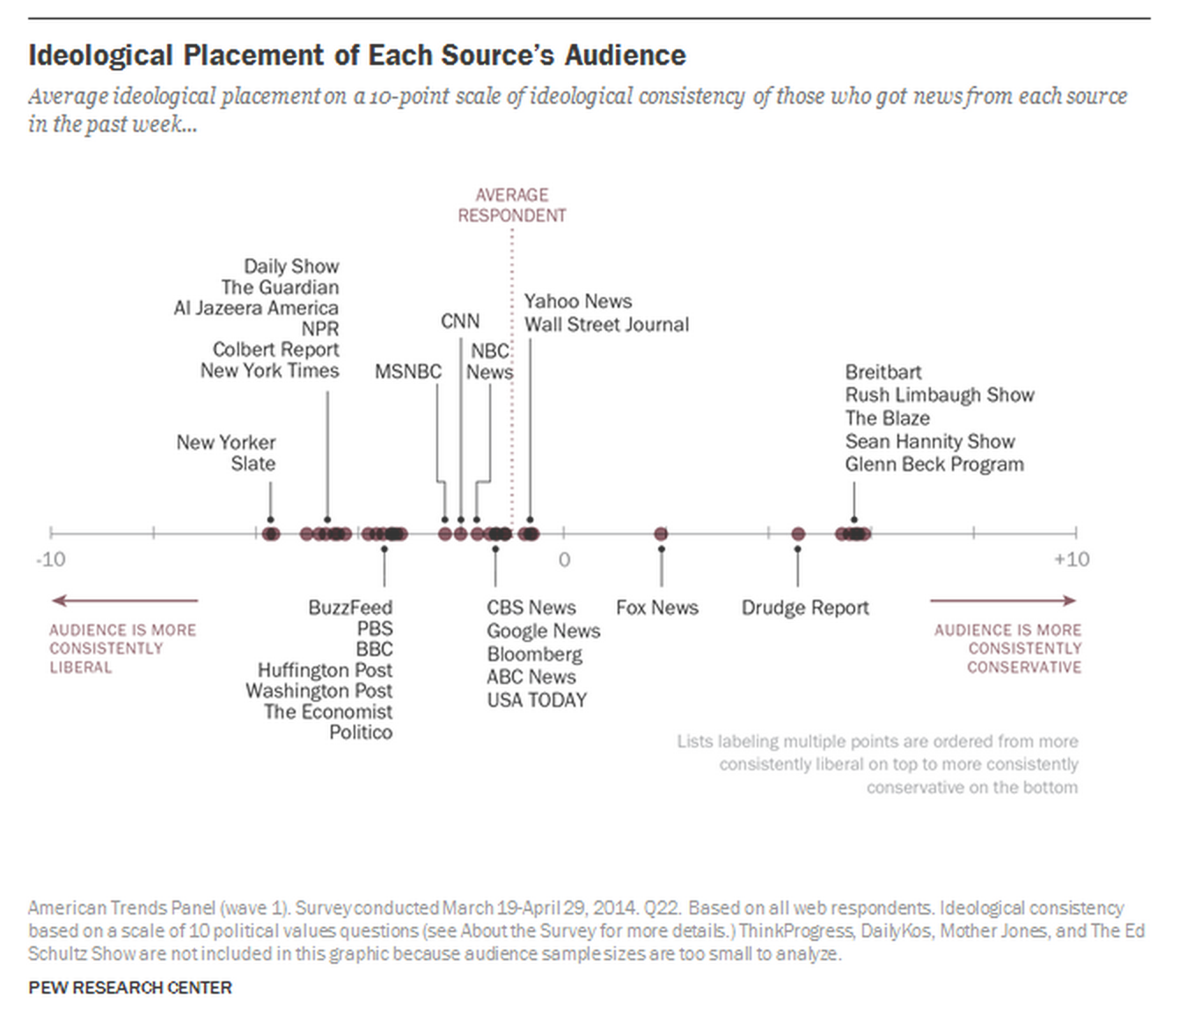

Slide 14
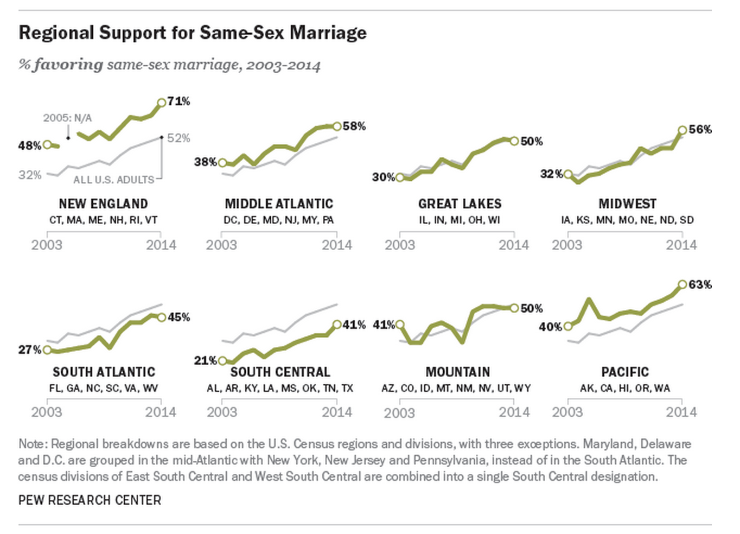

Slide 15

What about qualitative data?
Why? | Types | Chart selection | Aesthetics and design | How?

Slide 16
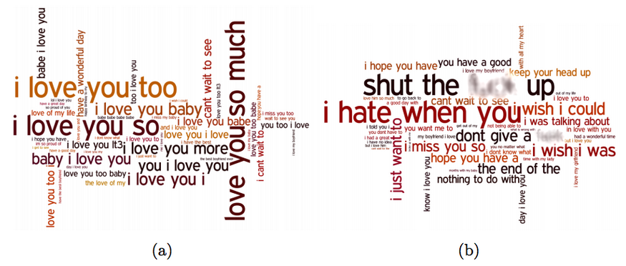
Notes:
https://twitter.com/motherboard/status/514460308539457536/photo/1?ref_src=twsrc%5Etfw

Slide 17
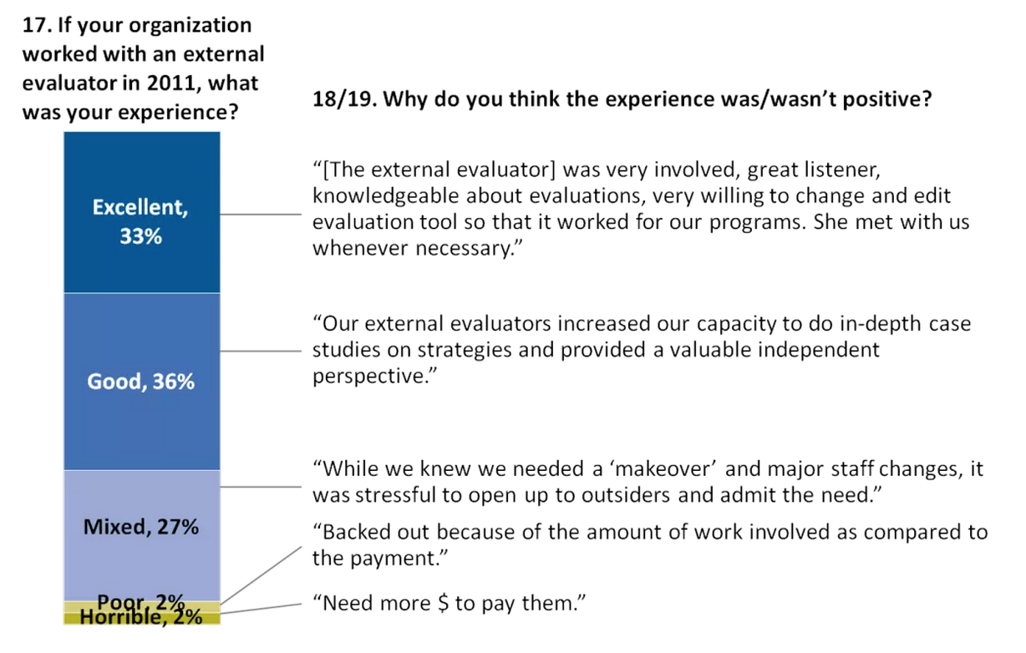
Notes:
http://annkemery.com/qual-dataviz/

Slide 18
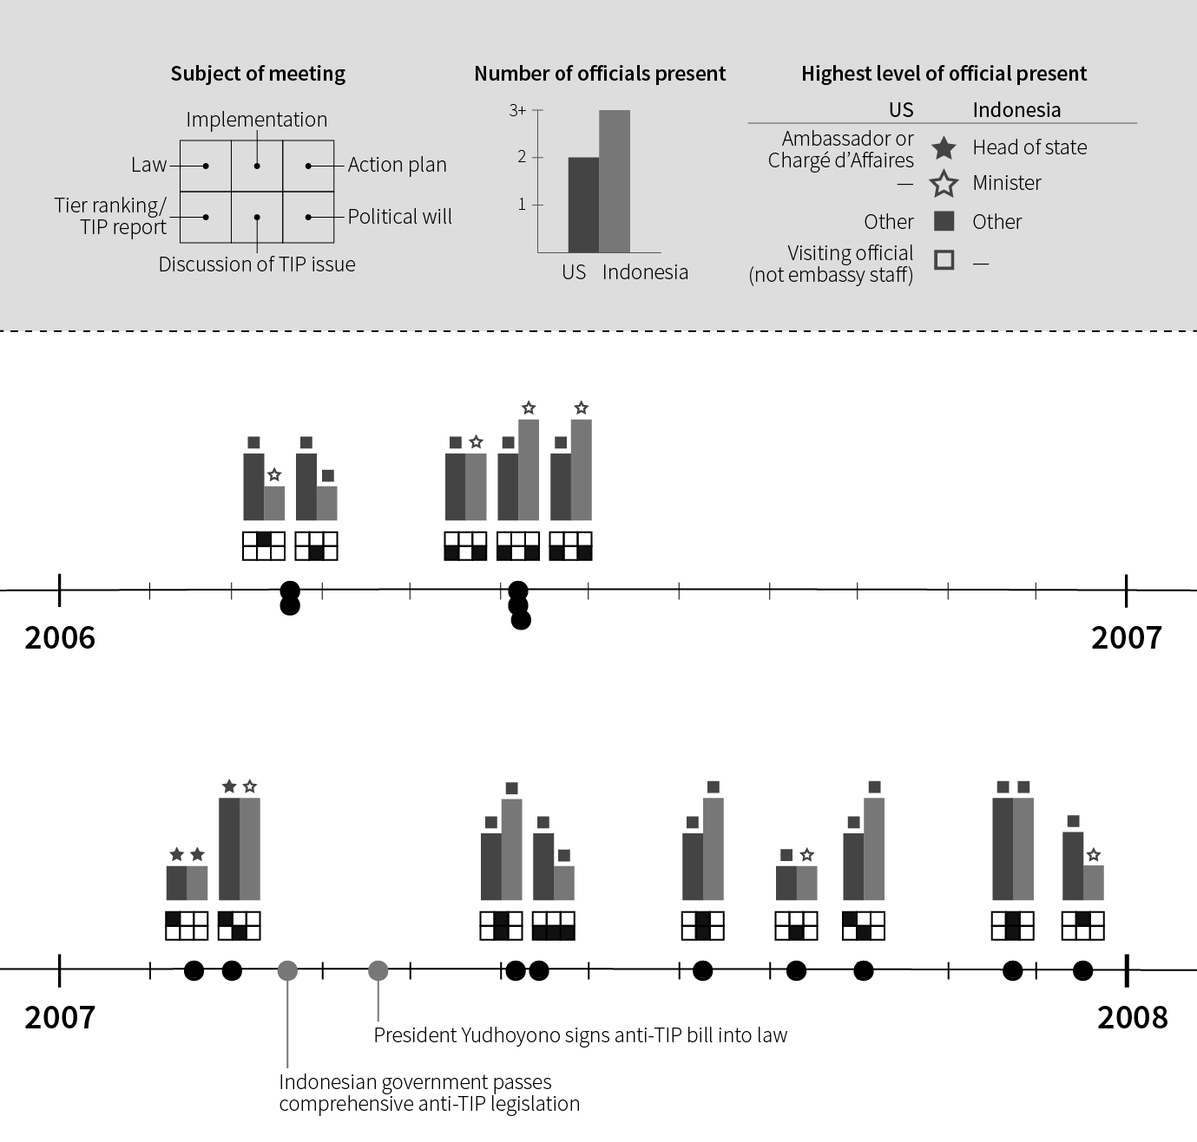

Slide 19
When do I use which kind of chart?
datavizcatalogue.com
Why? | Types | Chart selection | Aesthetics and design | How?
Notes:
Image via http://extremepresentation.typepad.com/files/choosing-a-good-chart-09.pdf; see also http://thegraphiccontinuum.bigcartel.com/product/the-graphic-continuum and http://policyviz.com/presentations/graphic-continuum-video/

Slide 20




What makes good design?
Contrast
Repetition
Alignment
Proximity
Why? | Types | Chart selection | Aesthetics and design | How?

Slide 21
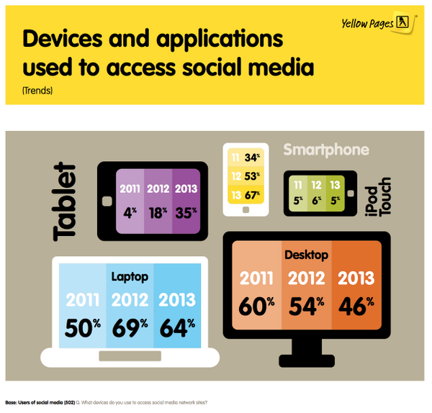
Infographics and chart porn
Why? | Types | Chart selection | Aesthetics and design | How?
Notes:
Resources: http://terribleinfographics.tumblr.com/
http://wtfviz.net/
http://vizwiz.blogspot.com/2014/06/makeover-monday-face-pie-taking-analogy.html
https://source.opennews.org/en-US/articles/when-map-shouldnt-be-map/

Slide 22
How do I do all this?
Excel / Tableau
R
Illustrator / Inkscape
Stata / SPSS / SAS
Why? | Types | Chart selection | Aesthetics and design | How?
Notes:
Stata menus are incredibly useful and contain pretty much every option you need to graph 80%ish of the stuff here.
But Stata is not the greatest thing out there for graphics – it’s been discussed on their mailing lists
R produces publication-worthy graphics, especially with the ggplot2 package – based on the Grammar of Graphics, lets you add layers of data, get really dense, beautiful plots
R is another statistical programming language, but it’s fairly intuitive (and free and open source!). Plus you can technically do all your data cleaning and analysis in Stata and then just graph stuff in R – you just have to learn the basics of ggplot to get things working

Slide 23
Let’s make a pretty picture
http://andhs.co/807excel

